Slide 1
Upload Excel for library opening hours
Yoel Kortick
Senior Librarian

Slide 2
Agenda
Introduction | I
The process | II

Slide 3
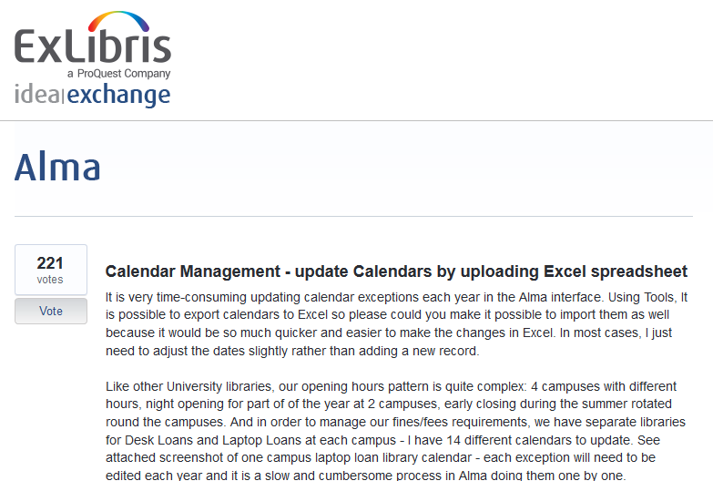
Introduction

Slide 4
Introduction
With the April 2019 release it is now possible to export the “Opening Hours” calendar, make changes, and then reimport.
This can be done on the library level and / or the institution level.
This is a great time saver, eliminating the need to manually edit multiple lines in multiple locations of the calendar.

Slide 5
Agenda
Introduction | I
The process | II

Slide 6
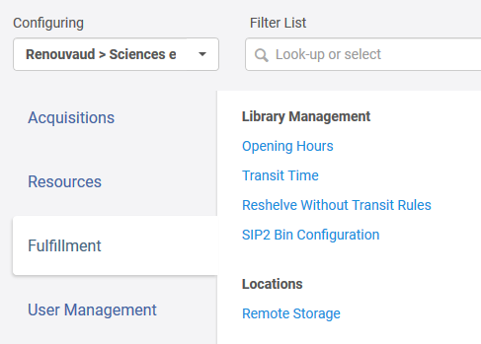
The process
Here we are configuring for the institution and access the “Opening Hours”

Slide 7
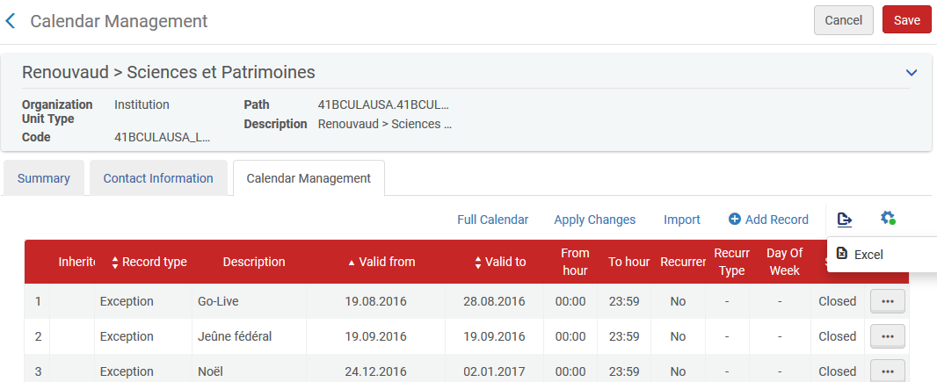
The process
Take note that we have an old “Go Live” exception and an outdated ““Jeûne federal” exception. We export the Excel.

Slide 8
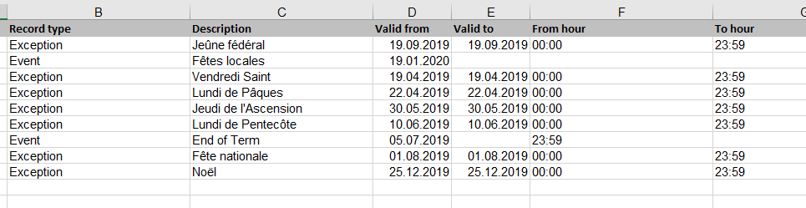
The process
Now as an example we remove all dates earlier than 28 Feb. 2019 including the Exception “Go Live”
We change dates of Exception “Jeûne federal” from “19.09.2016 – 19.09.2016” to “19.09.2019 – 19.09.2019”
We add Event “Fêtes locales” for Jan. 19, 2020

Slide 9
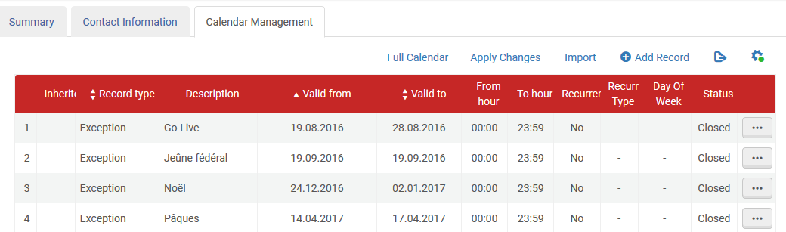
The process
And now we will import the Excel

Slide 10
The process
On the next slide note the statement “The uploaded file will replace (not append) all existing data. Changes will be applied after performing "Upload and Import" and then "Apply Changes".”
This means that the entire calendar gets replaced by the new Excel sheet. It does not just add new lines, it replaces the entire calendar.

Slide 11
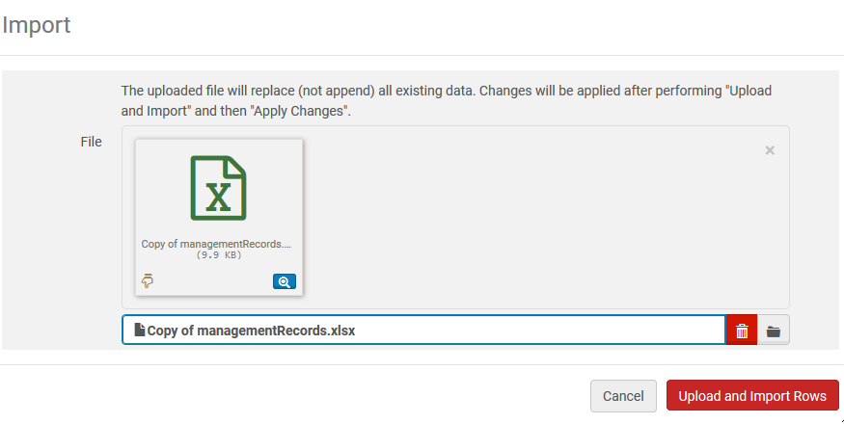
The process

Slide 12
The process
In next screen you will see that only the rows from the Excel file exist in the calendar.
The Exception “Go Live” has been removed
The dates of xxception “Jeûne federal” have changed from “19.09.2016 – 19.09.2016” to “19.09.2019 – 19.09.2019”
Event “Fêtes locales” for Jan. 19, 2020 has been added

Slide 13
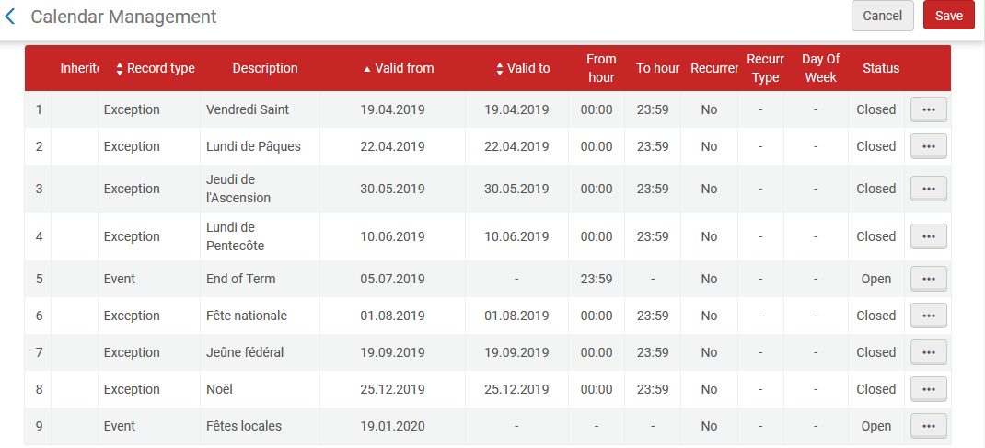
The process

Slide 14
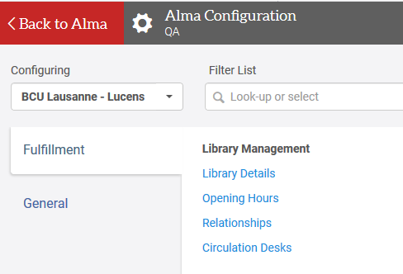
The process
Now we do the configuration on the libray level for BCU Lausanne - Lucens

Slide 15
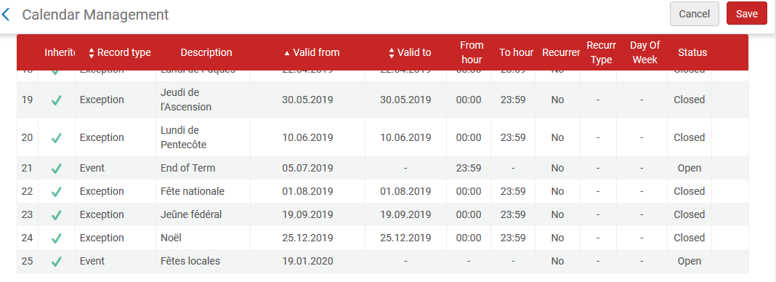
The process
Note that we have inherited values from what we did with the Excel sheet on the institution level.

Slide 16
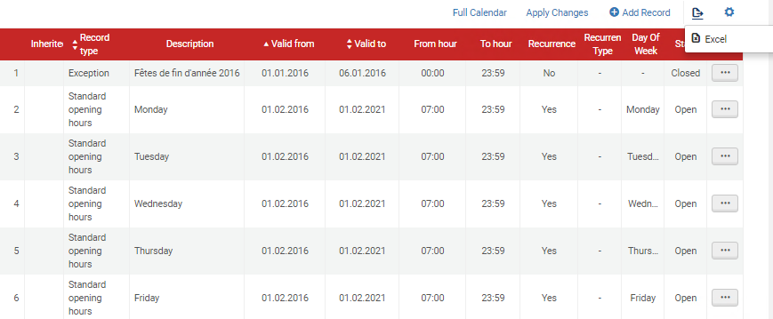
The process
Note that Monday to Friday are all defined to open at 07:00 and the dates are 01.02.2016 to 01.02.2021

Slide 17
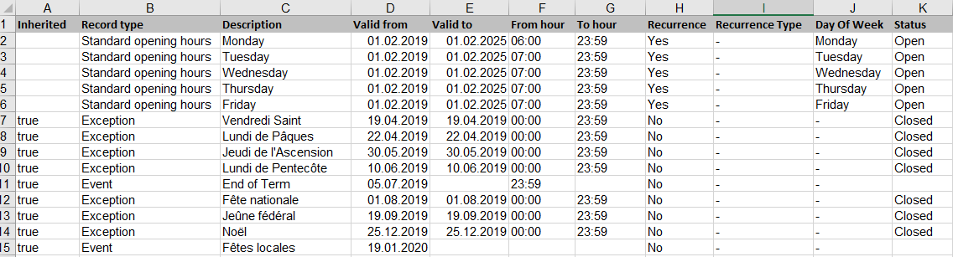
The process
We export the Excel for this library and (as an example) change the “Valid from” and “Valid to” dates for Monday to Friday to be 01.02.2019 to 01.02.2015. We also make Monday be open at 06:00 instead of 07:00.
Further, all old dates are removed.

Slide 18
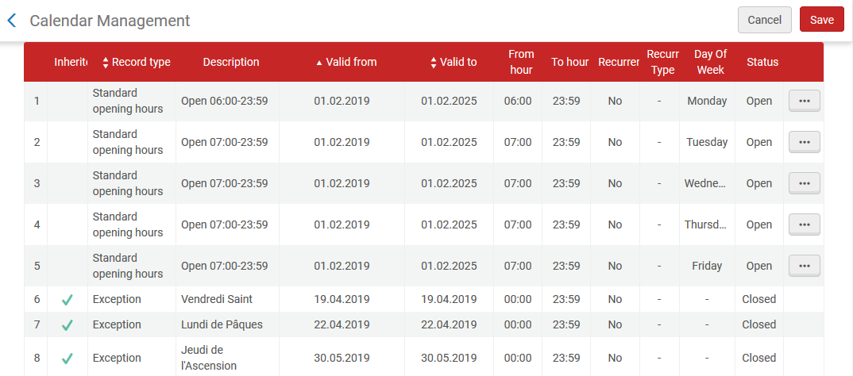
The process
The changes are made after import

